Slide 1
Drone delivery system unit
Day 4
Standards:
8.PS2.3
8PS2.4
8.PS2.5

Slide 2
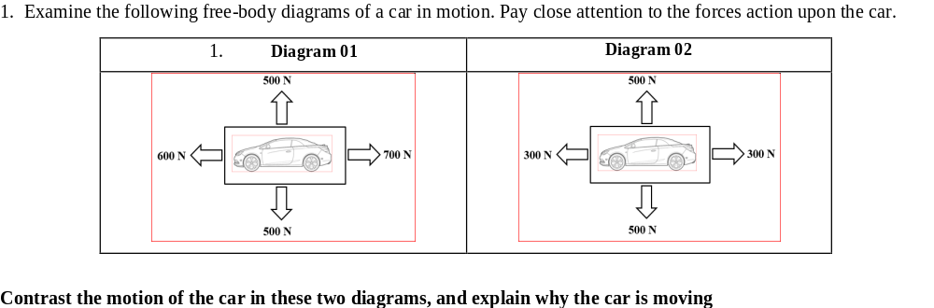
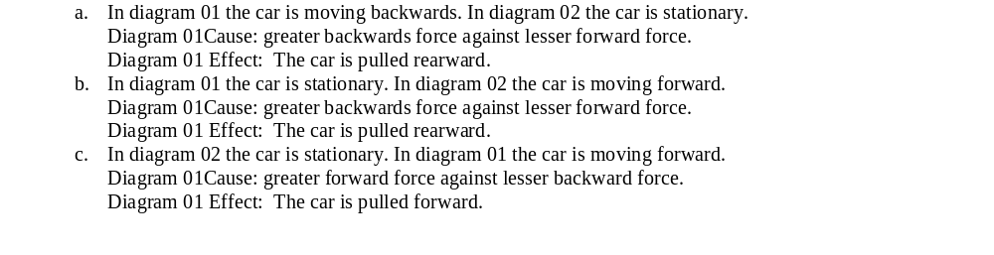

DQ
Standards: 8.PS2.3, 8PS2.4, 8.PS2.5

Slide 3
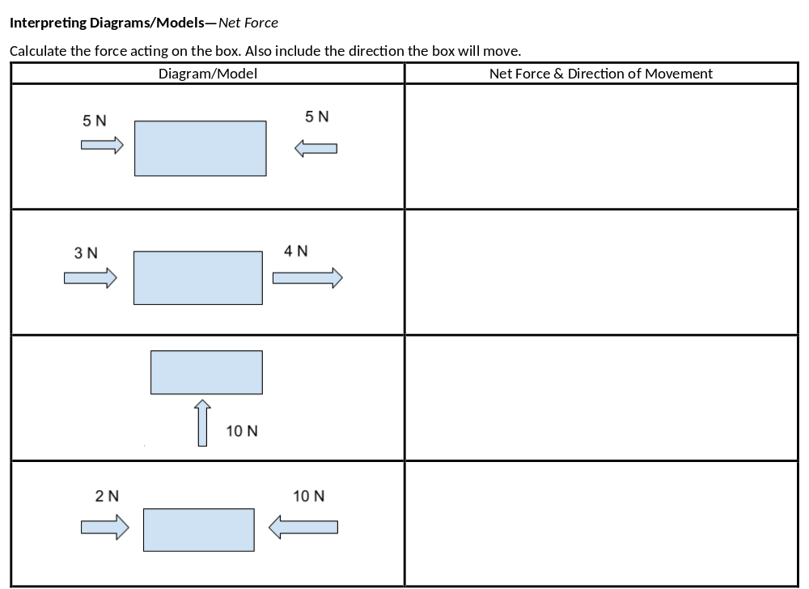
Draw this on a piece of paper and complete the empty boxes.

Slide 4
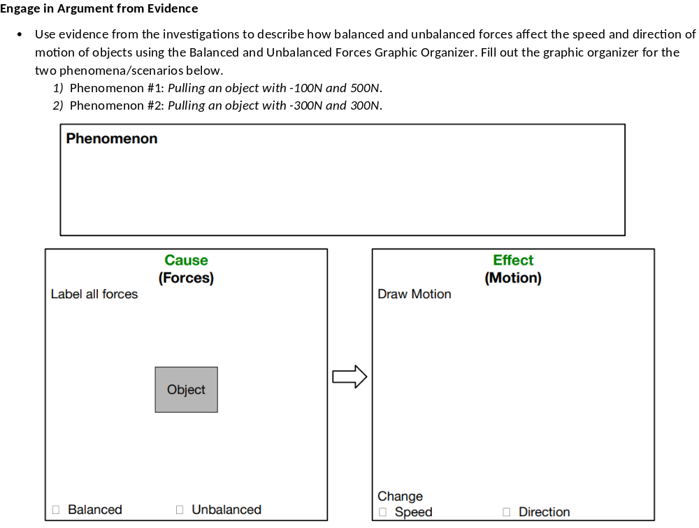
Turn this paper in when you have completed it. Make sure your name is at the top.

Slide 5
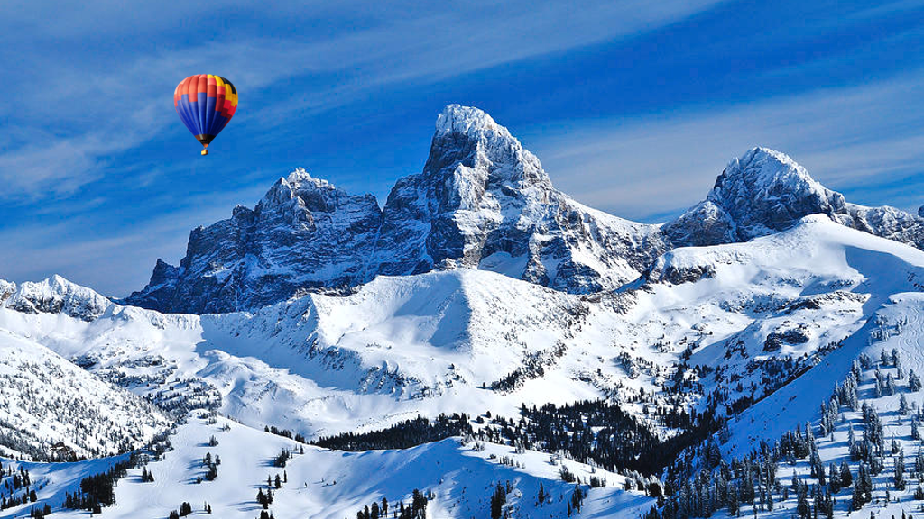
Standards: 8.PS2.3, 8PS2.4, 8.PS2.5

Slide 6
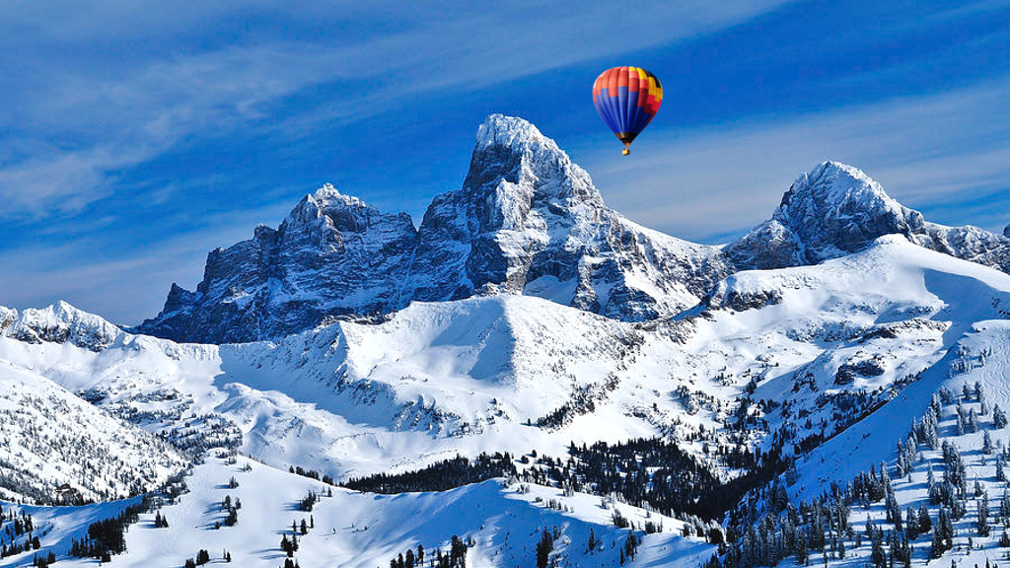
Standards: 8.PS2.3, 8PS2.4, 8.PS2.5

Slide 7
How do we know an object is moving or has changed position?

Slide 8
1. Read the scenario and write a statement that accurately describes the student’s motion: A student is sitting in a moving school bus. Through the bus window, the student sees a fire hydrant at an intersection pass by and out of sight as the bus travels down the road.
________________________________________________________________________________________________________________________________________________________________________________________________________________________________________________________________________________________________________________________________________________
2. Now that you know more about relative motion, re-write your statement:
________________________________________________________________________________________________________________________________________________________________________________________________________________________________________________________________________________________________________________________________________________

Slide 9
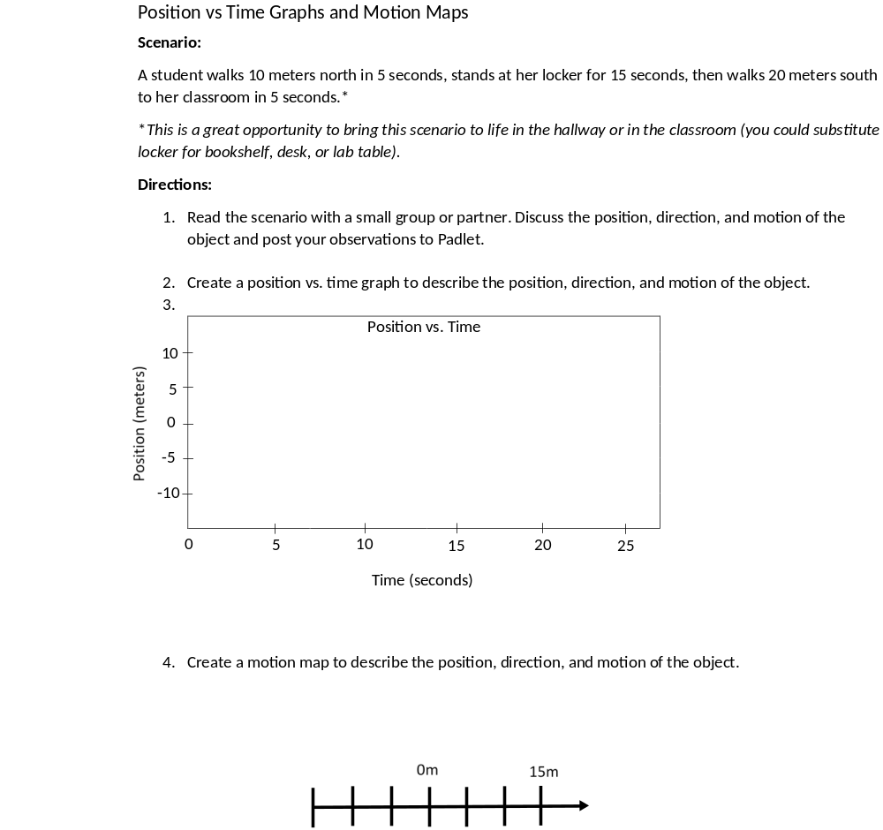
How to draw motion maps

Slide 10
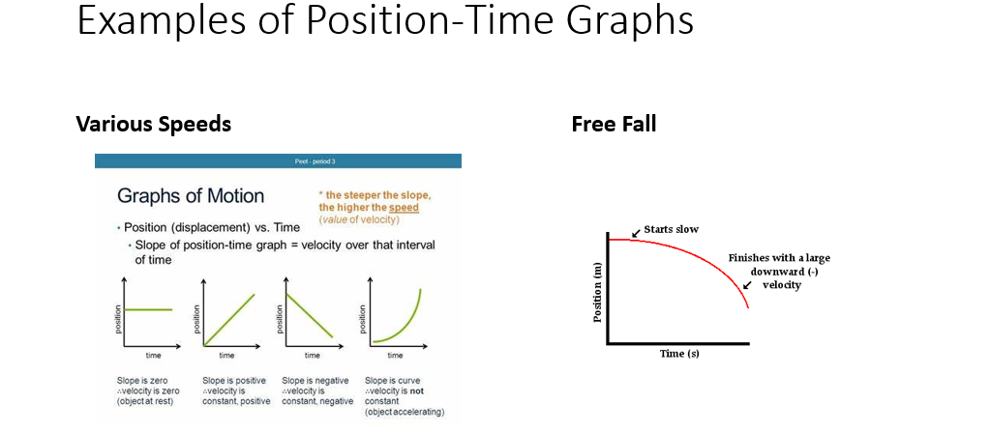

Slide 11
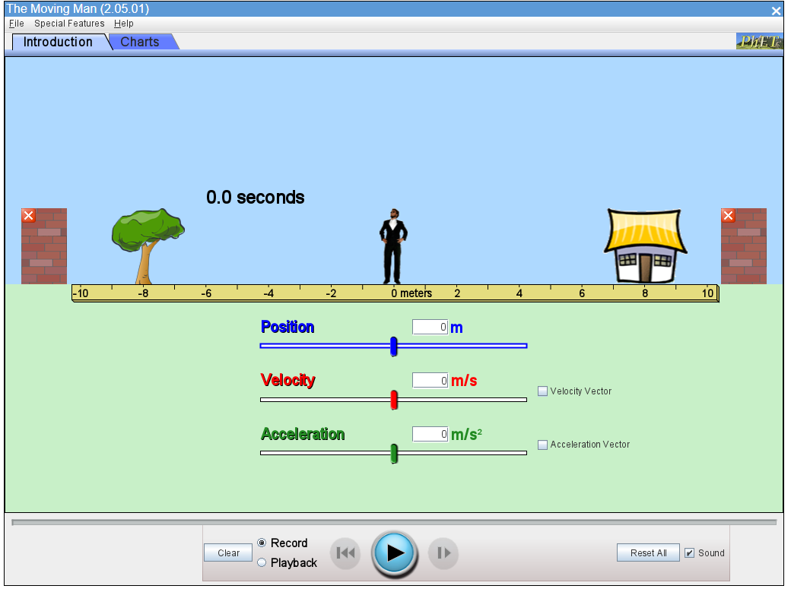
The Moving Man
Go to TEAMS and open the assignment The Moving Man.
Follow along for this activity.

Slide 12
Revise your initial model
Add position-time graph and or motion map or anything else you learned today.

Slide 13
Exit Ticket:
What is Newton’s First Law of Motion?

